Slide 1
Project Report
AI Powered Level 3 Chat-bot Made With RASA
Presented By:
Prakhar Sharma
1810991997

Slide 2
What is RASA and Why RASA?
Rasa is the leading conversational AI platform, for personalized conversations at scale.
Rasa provides flexible conversational AI for building text and voice-based assistants.
Rasa uses State-of-the-art NLU research
Rasa provides Customizable infrastructure which makes it more easier to implement.
We are also not tied to a pre built model and can make our own model also.

Slide 3
RASA components and its use.
RASA has 2 main components i.e RASA NLU & RASA CORE.
NLU is Natural Language Understanding. Suppose the user says “I want to order a book”. NLU’s job is to take this input, understand the intent of the user and find the entities in the input.
Here the intent is of ordering a book and entities can be book.
Rasa NLU internally uses Bag-of-Word (BoW) algorithm

Slide 4
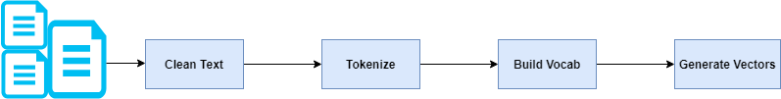
Understanding BOW Algorithm
Lets say we have 2 sentences:
1. John likes to watch movies. Mary likes movies too.
2. John also likes to watch football games.
Tokenize it like this: {"John":1,"likes":2,"to":1,"watch":1,"movies":2,"Mary":1,"too":1}
Combining both tokenizers will look like: {"John":2,"likes":3,"to":2,"watch":2,"movies":2,"Mary":1,"too":1, "also":1,"football":1,"games":1}

Slide 5
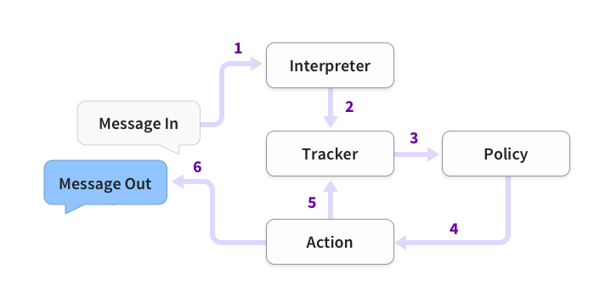
RASA components and its use.
The job of Rasa Core is to essentially generate the reply message for the chatbot.
It takes the output of Rasa NLU (intent and entities) and applies Machine Learning models to generate a reply.

Slide 6
How I made ChatBOT with RASA.
At first I have initalized the rasa in a virtual environment with python in it using the the command rasa init.
Then I got a pre-trained basic model which I have modified it to restaurant booking model.
I have made changes to almost every file like domain.yml, actions.py, nlu.yml etc.
I have also made custom action for checking the booking time given by the user if it is valid or not and also if restaurant is open at that time.

Slide 7
Connectivity With DATBASE
I have used MySQL as the database for storing the reservations made.
Python connector is used to connect my actions.py file with the MySQL server.
For getting the booking timestamp datetime library of python is used.
Entities like time and day were extracted from user input and then fed to MySQL Database

Slide 8
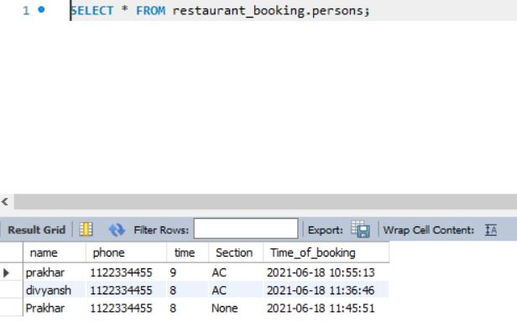
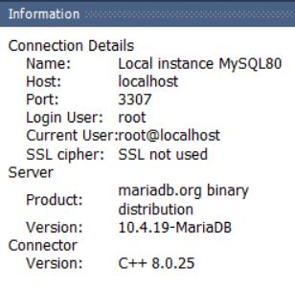
Connectivity With DATBASE.

Slide 9
Integrating BOT with TELEGRAM.
First we have to go to BOT-FATHER in TELEGRAM app.
Then we will initialize our bot and give it a name.
After that TELEGRAM will give us a unique API key which we will integrate in our credentials.yml
Then we will start our server using ngrok making our machine as server which will send signal to api and fetch and request responses.

Slide 10
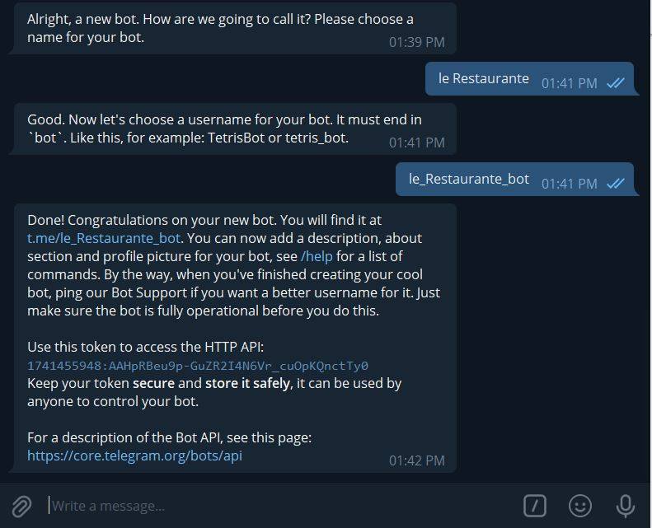
Integrating BOT with TELEGRAM

Slide 11
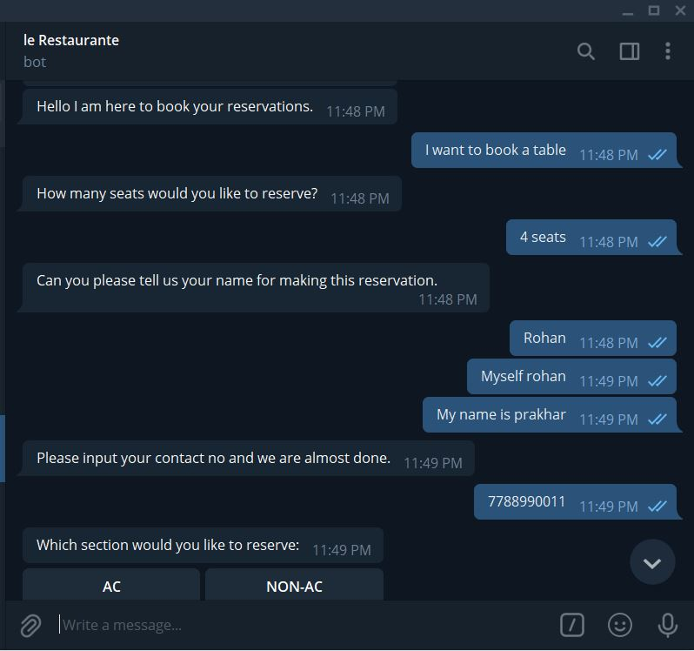
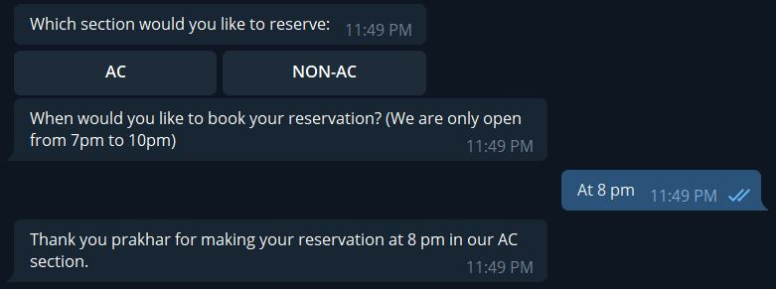
Using our ChatBOT in Telegram

Slide 12
Making GUI with PYQT
I have used PYQT for making the GUI of my project.
Adding custom actions and opening the RASA-X with GUI after the Main Window is fully Loaded.
Added a progress bar with a functionality in main gui.
Only after completion of progress bar the RASA bot will get started using localhost server.

Slide 13
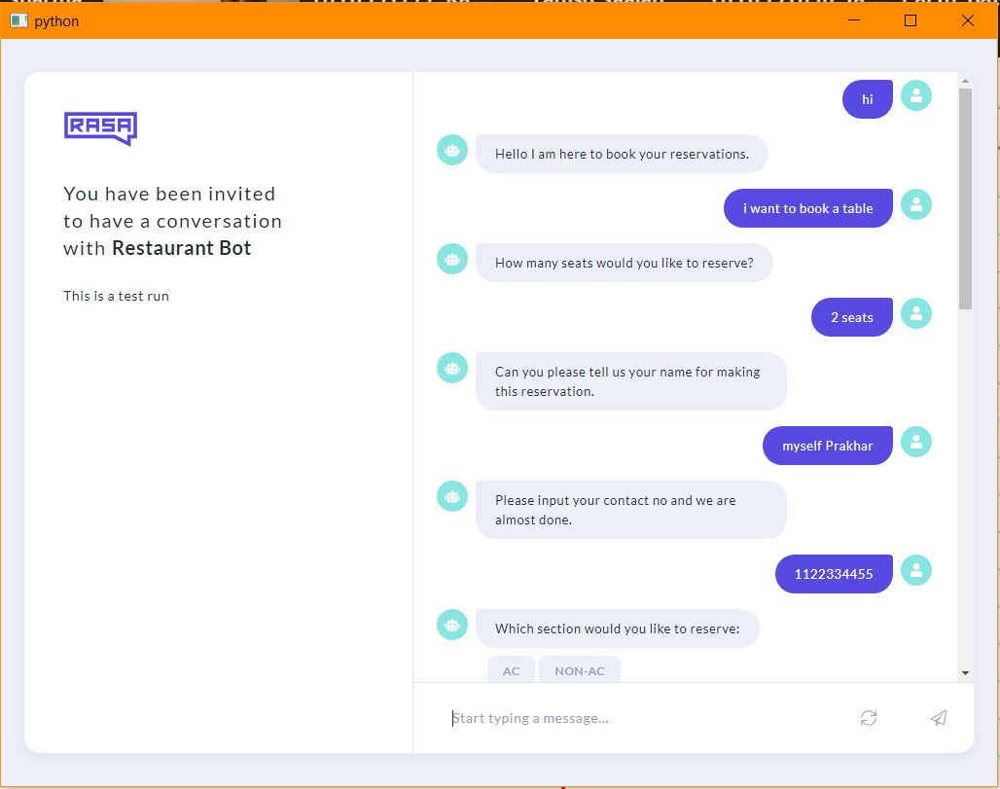
GUI

Slide 14
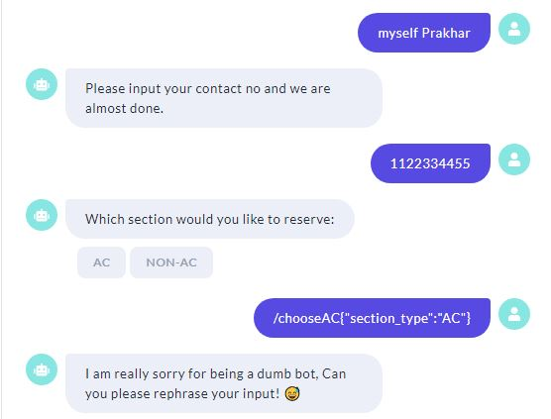
GUI

Slide 15
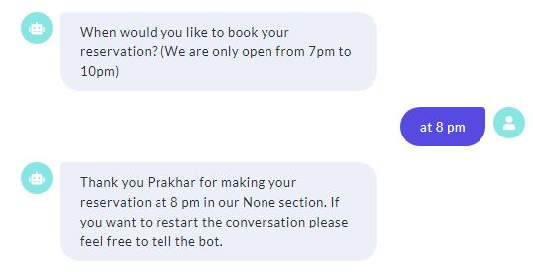
GUI

Slide 16
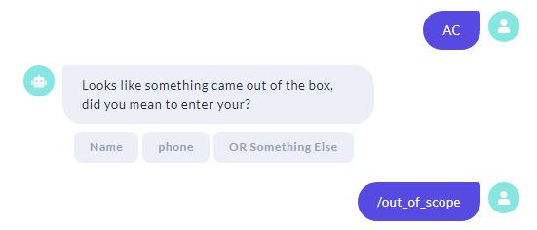
Handling Abrupt input
Here Rasa is easily handling inputs which were recognized with low confidence and ask the user if it was name or phone number or something else.

Slide 17
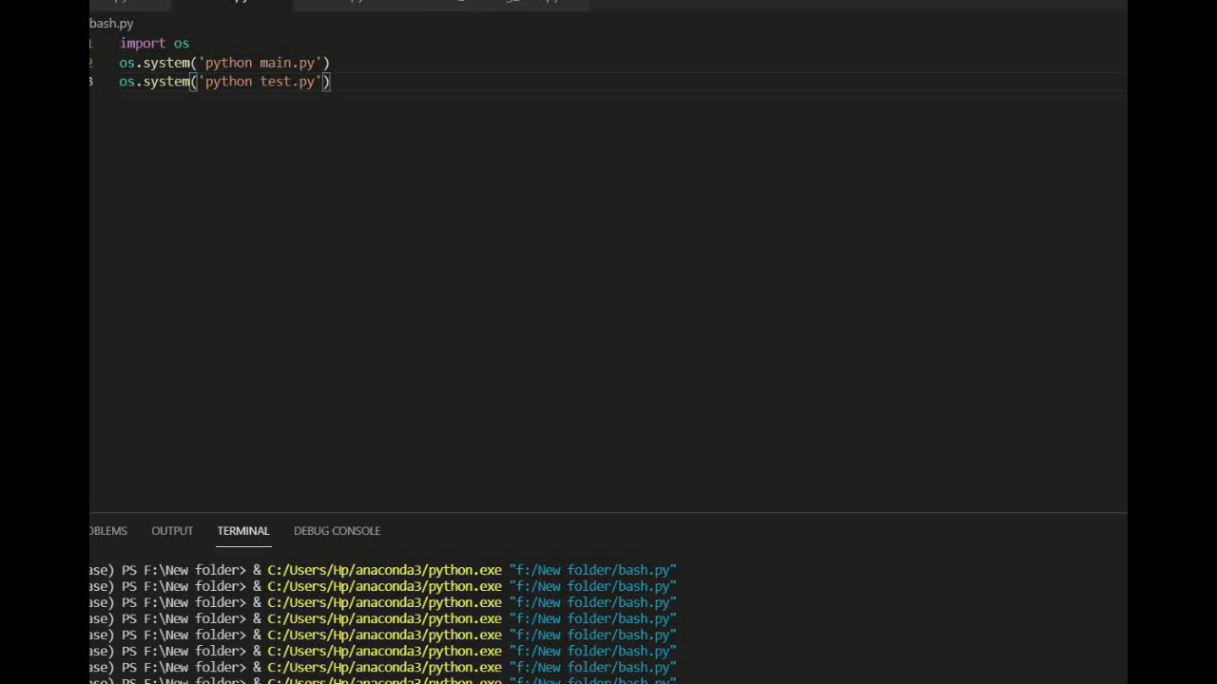
GUI & Working Tutorial video

Slide 18
Thank YOU

